Slide 1
Conditional syntax
Week 3

Slide 2
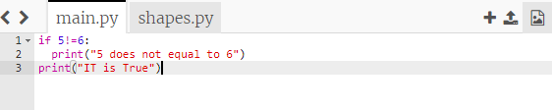

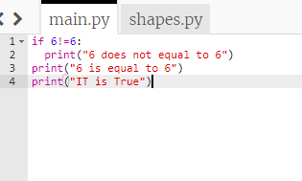

Conditional Statements: Conditional statements are also called decision making statements, we use those statements while we want to execute a block of code, when the given condition is true or false

Slide 3
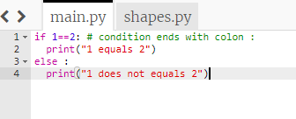
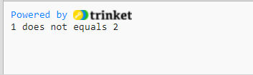
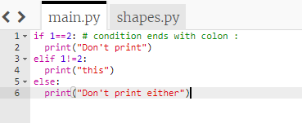

Else Statement:

Slide 4
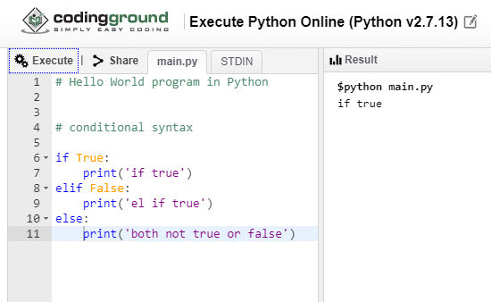
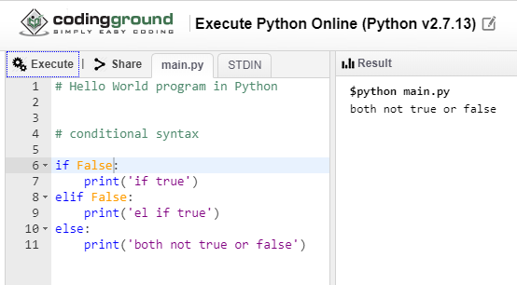
Example

Slide 5
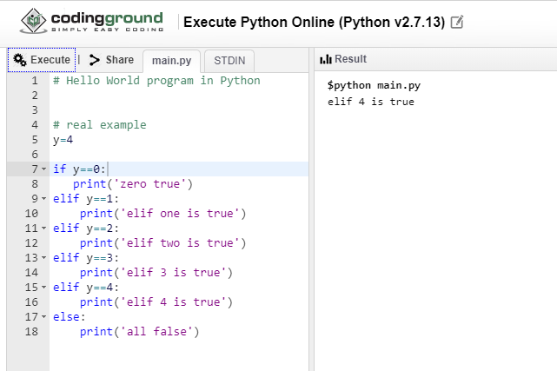
Real example

Slide 6
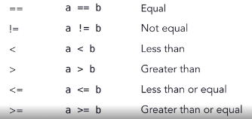
Conditional operators We will start with comparison operators

Slide 7
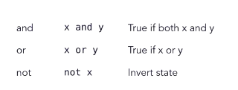
Logical operators

Slide 8
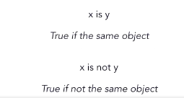
Identity Operator

Slide 9
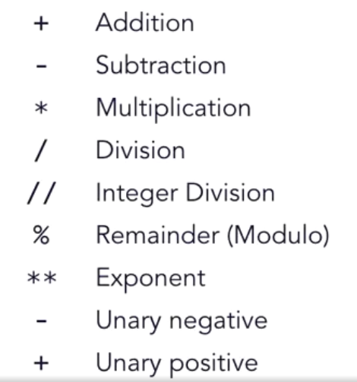
Arithmetic operators

Slide 10
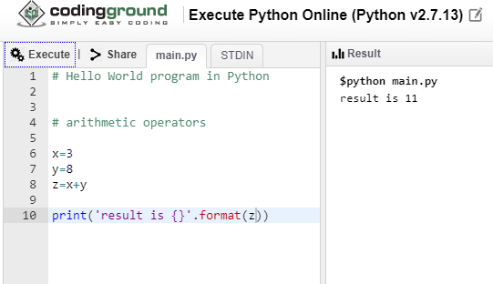
Examples

Slide 11
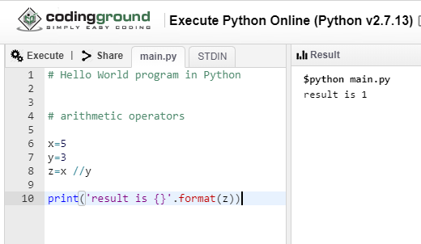
// If I want to get the integer division then I use two slash marks for the operator and when I save and run, I get a result of one which is five divided by three without the remainder.

Slide 12
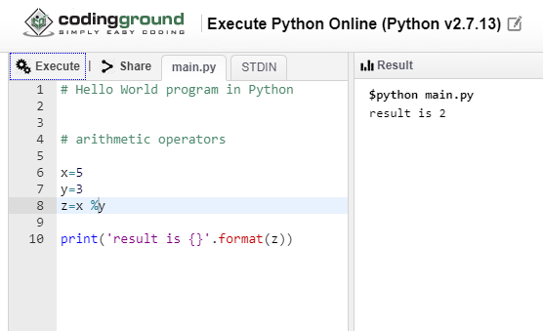
If I want the remainder, I use the percent sign which will give me the remainder or the modulus.

Slide 13
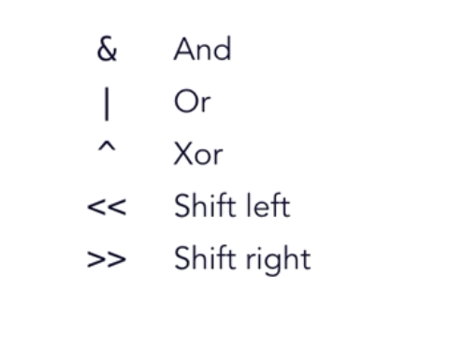
Bitwise operators

Slide 14
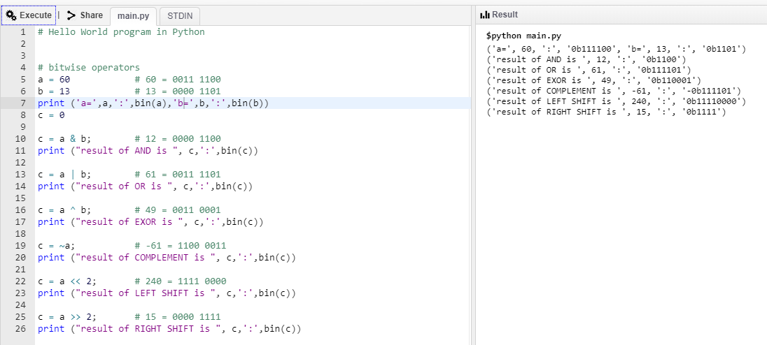
Example

Slide 15
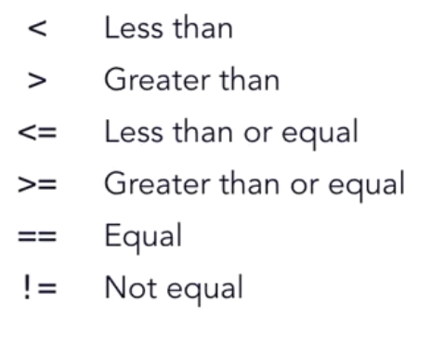
Comparison operators

Slide 16
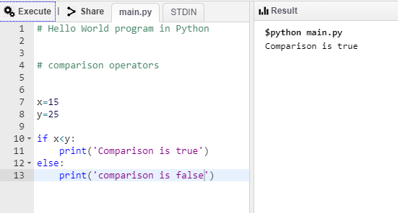
Example

Slide 17
